Slide 1
Long Short-Term Memory Networks for Time-Series Predictions
Eliot Liucci

Slide 2
Motivation
Modern advances in tech allow for continuously measured data (or time-series data) to be more readily available in a variety of fields
Weather
Stocks
Population
Accurate predictions are beneficial in the case of atypical trends
Harsh conditions
Unnatural stock behavior
Unexpected increases/decreases in population

Slide 3
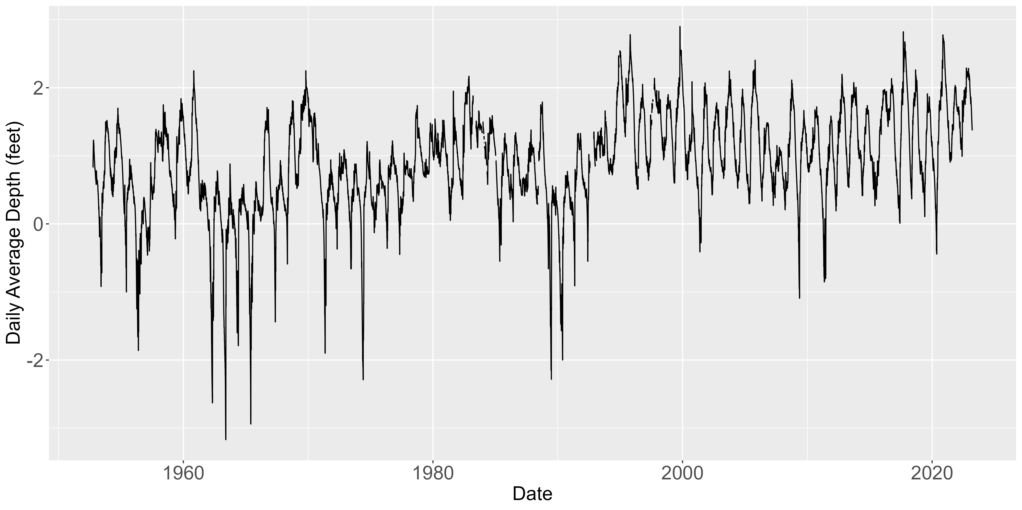
Data Available
Everglades National Park (EVER) telemetry stations monitor water depth
Range as far as 1952 – 2023
Various levels of missingness
Measurements are daily averages
Originally “Stage” (water elevation)
Converted to Depth based on station elevation

Slide 4
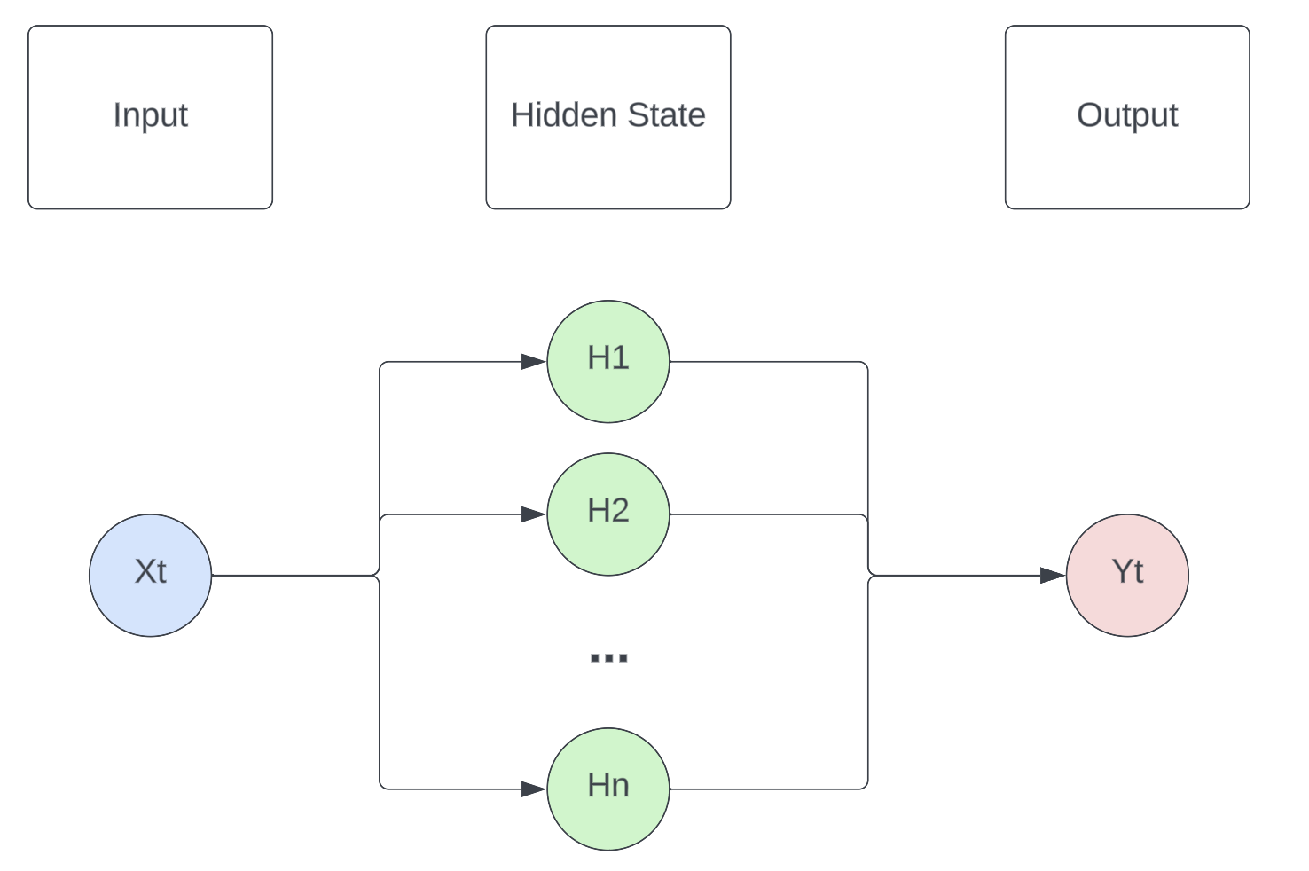
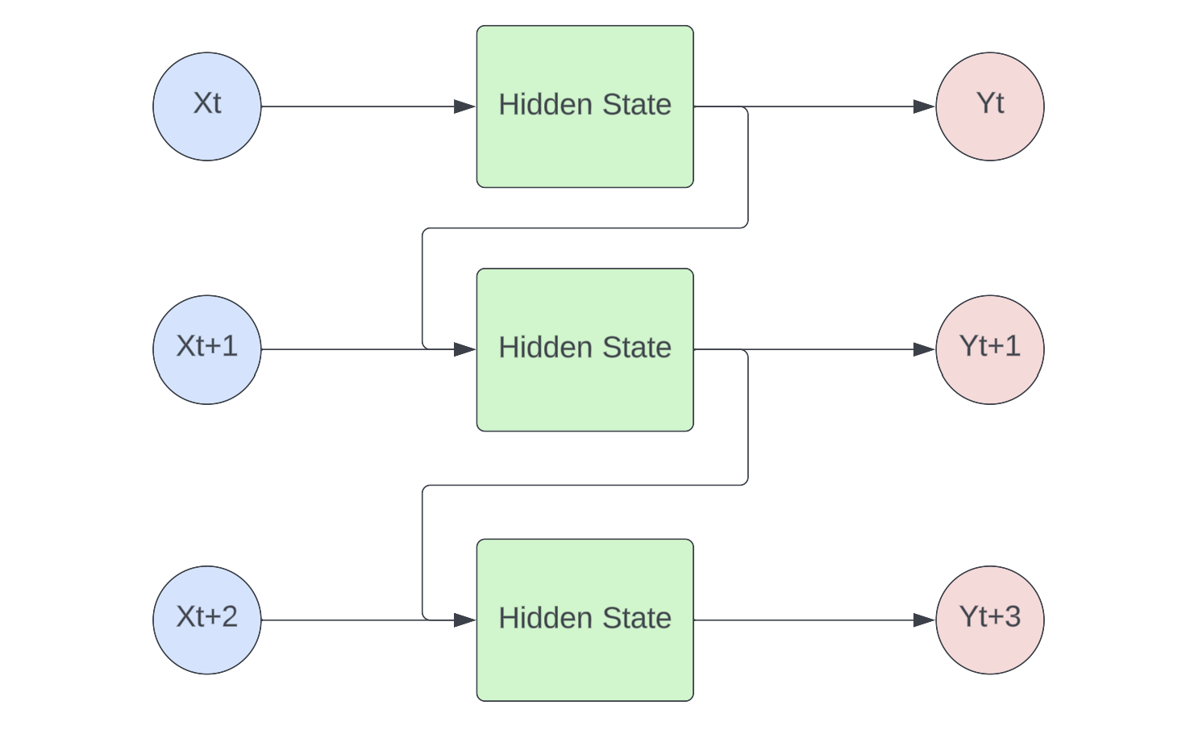
Recurrent Neural Networks
Traditional Neural Network
Recurrent Neural Network
Graphics made using Lucid Chart

Slide 5
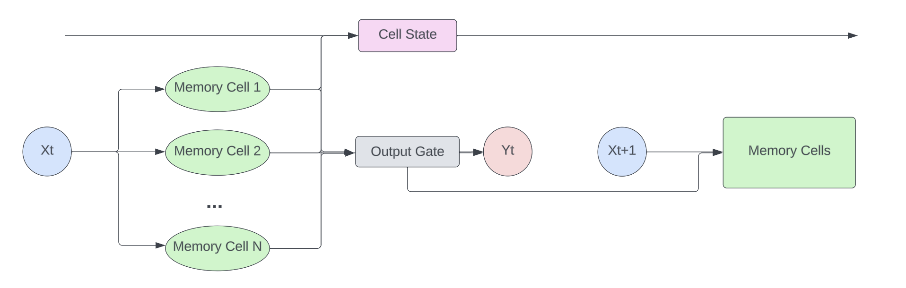
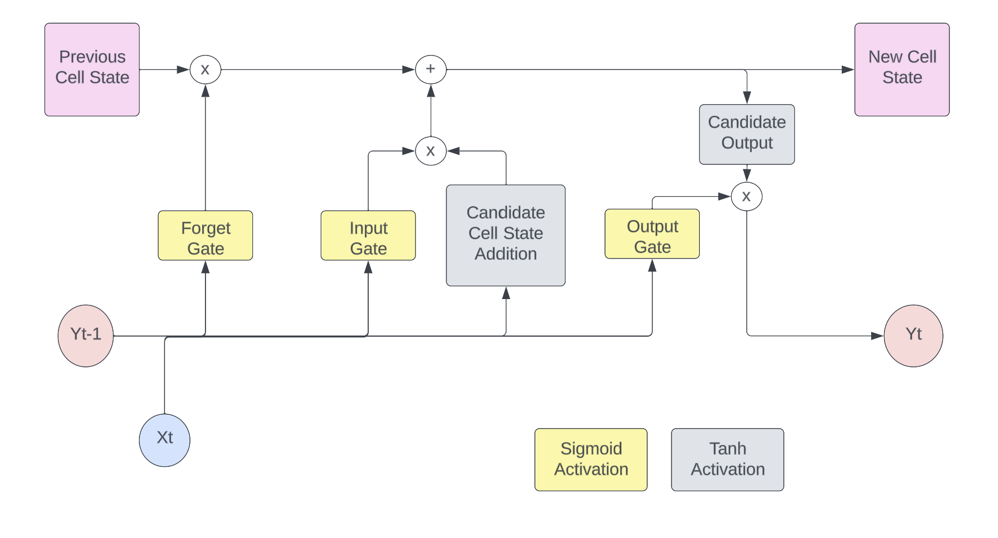
Long Short-Term Memory Networks

Slide 6
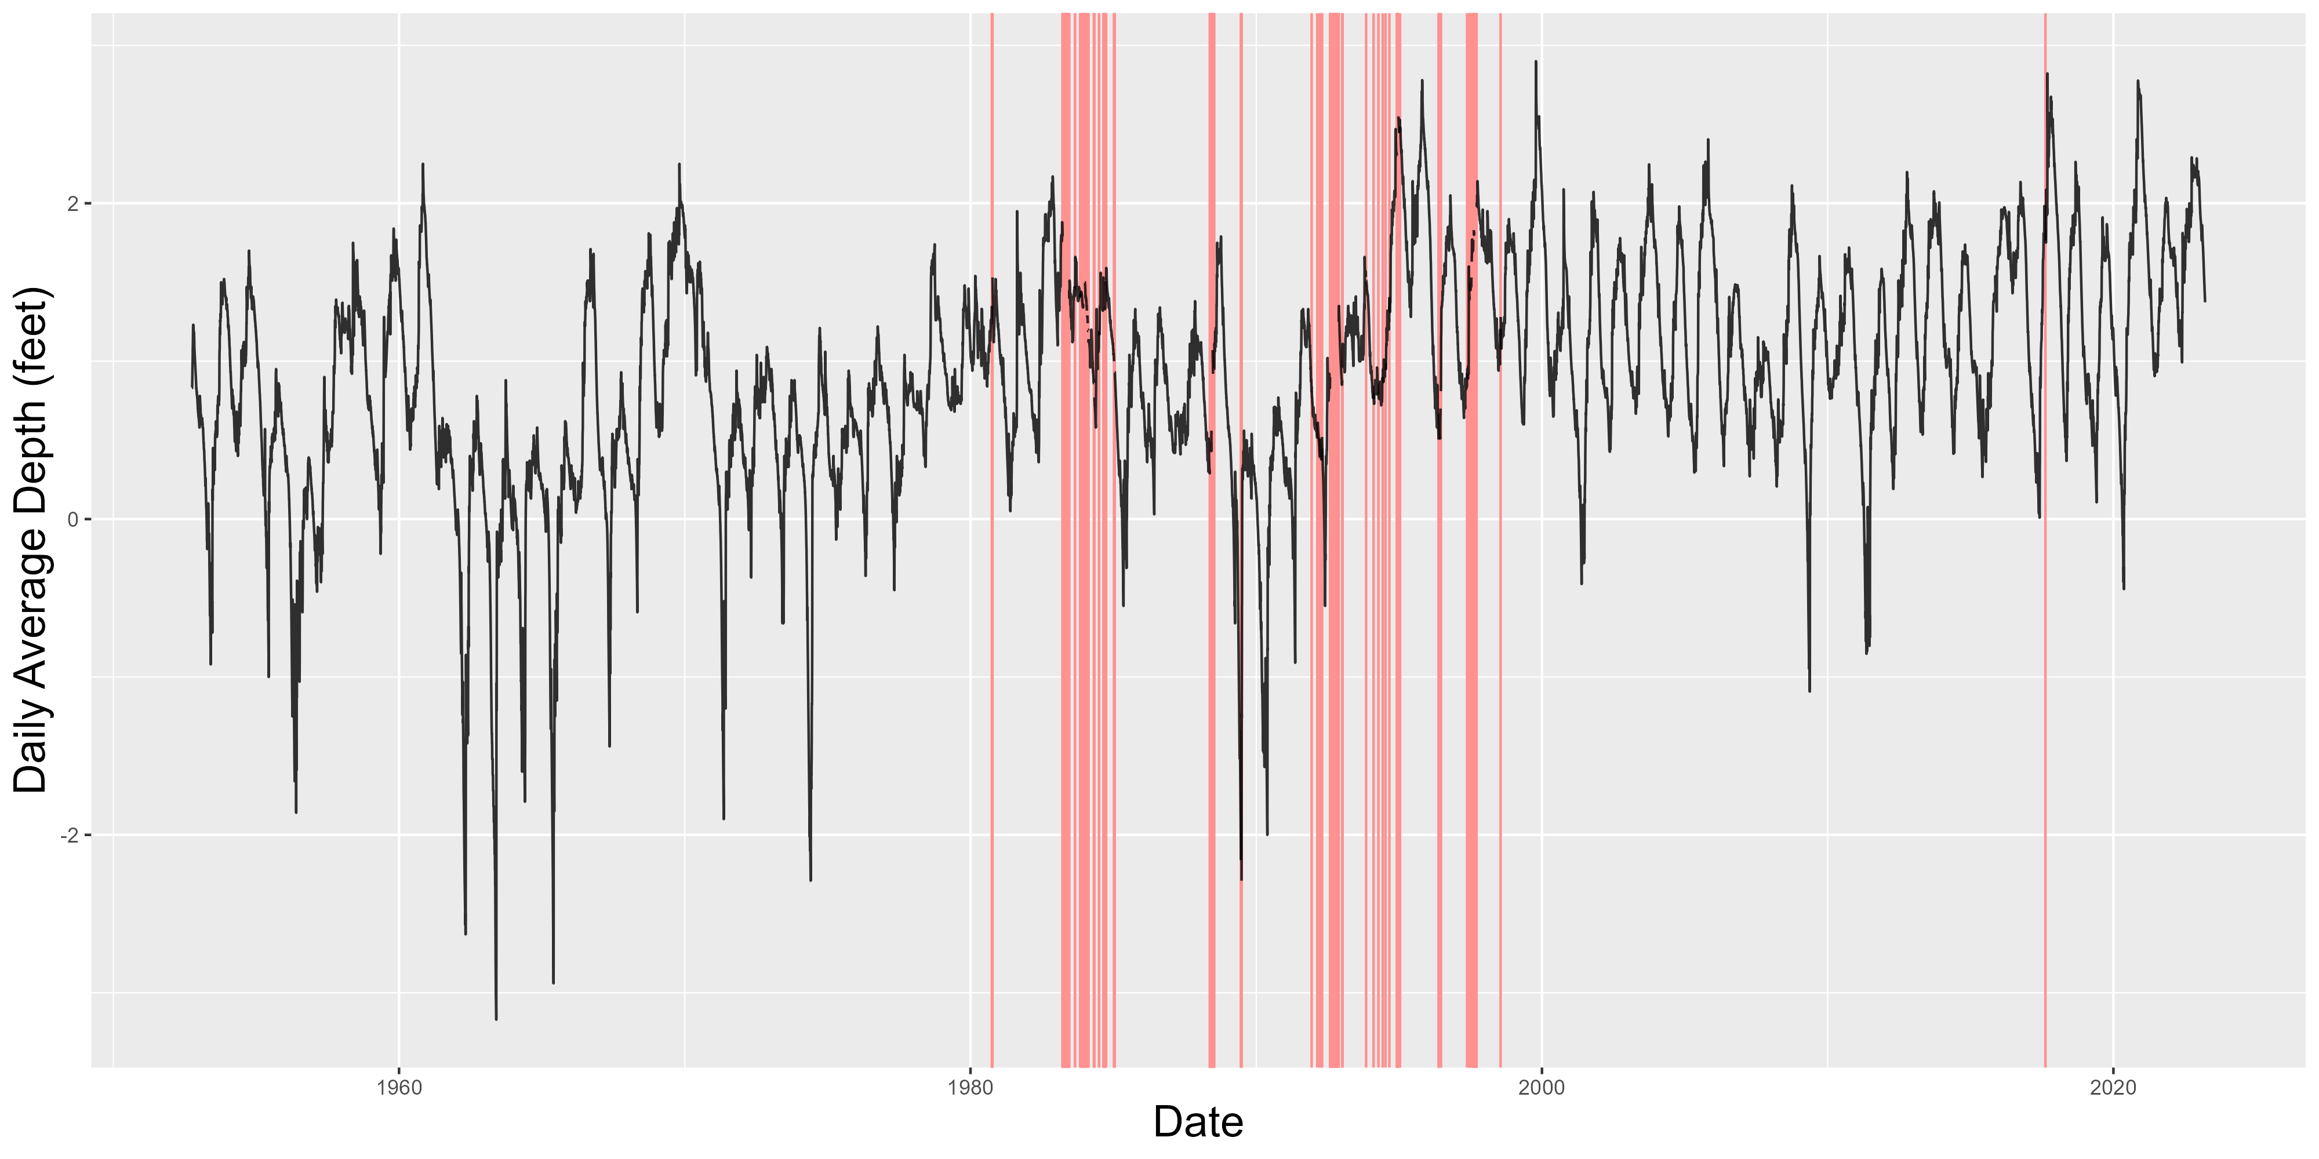
Potential Issue - Missingness
Missingness when training NNs can lead to exploding gradients, so missing values must be fixed
Linear Interpolation was used to fill in those values

Slide 7
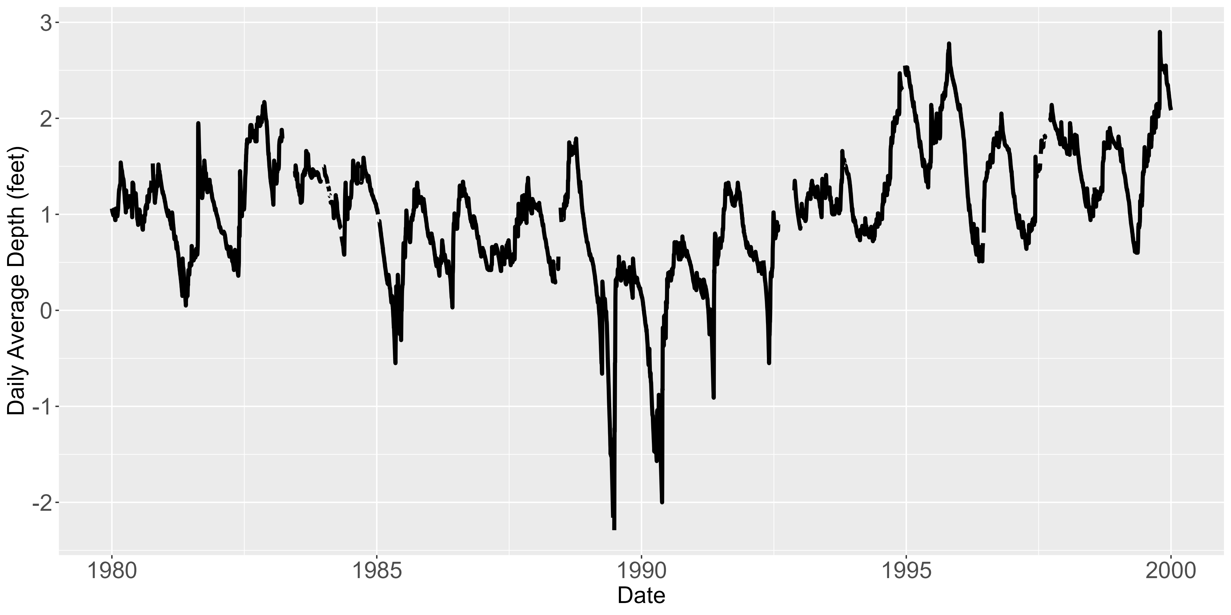
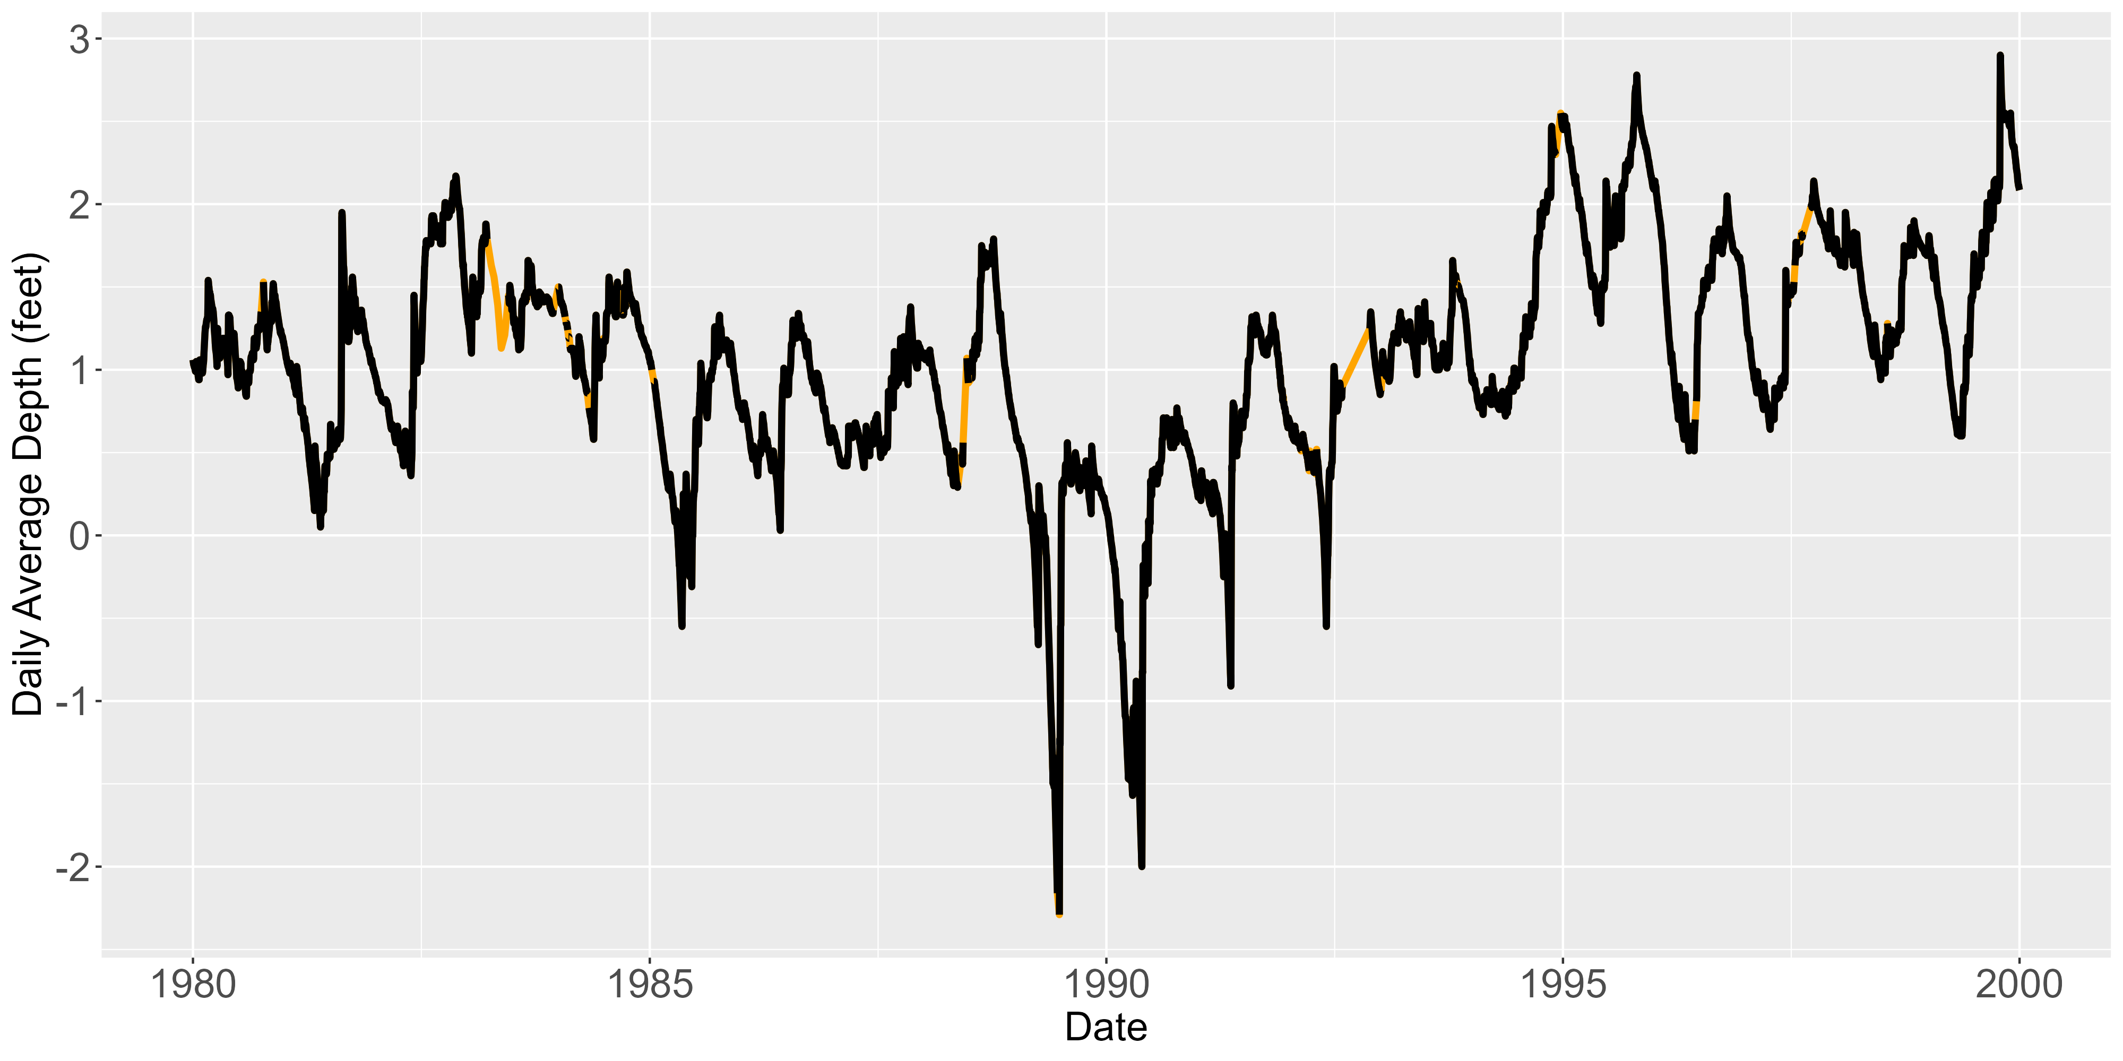
Line plot of P33 after imputation (focused on 1980 to 2000)
Line plot of P33 before imputation (focused on 1980 to 2000)

Slide 8
Comparison to Traditional Methods
Pros
Cons
Given proper computer power, very easy to train
Doesn’t require understanding of autocorrelation
Doesn’t require assumption of functional form that ARIMA models take
Require significantly more data to train
Computationally expensive
Missingness can cause issues
Data must be scaled
Interpretation of parameters is non-existent
Black Box of Neural Networks

Slide 9
Results (LSTM vs. ARIMA)

Slide 10
Next Steps
Bayesian Optimization for hyperparameter tuning
Ideal architecture?
Obtain uncertainty intervals for LSTM predictions
Bootstrap from training sample
Bootstrap
Retrain Network
Obtain Predictions
Repeat

